Slide 1
Chapter 7
Electronic Business

Slide 2
Outline
What types of products are sold online?
How do Web-based services work and why do they change the world?
How can customers pay for products and why do you need new payment mechanisms?
How do firms get revenue from Web ads and how do customers find a site?
How do you create an EC Web site?
How do portable Internet connections (mobile phones) provide new ways to sell things?
When do consumers and businesses pay sales taxes on the Internet?
Does the Internet create a global marketplace?
What are the costs for cloud computing?

Slide 3




Electronic Business
Salesperson
Service, orders, and information
Orders, Auctions, and EDI
Large business
Small business/ supplier
Sales and CRM
The Internet
Web hosting and Web-based services
Consumers
Customer

Slide 4
Forms of Electronic Commerce
 | Business | Consumer
Business | B2B EDI Commodity auctions Services | B2C Consumer-oriented Sales Support
Consumer | C2B Minimal examples, possibly contract employee sites such as vworker.com | C2C Auction sites (eBay) But many of these are dominated by small business sales. Social networks

Slide 5
Marketing Phases
Pre-Purchase
Static data sites.
Promotion.
Product specifications.
Pictures.
Schematics.
Pricing.
FAQs.
Interactive sites.
Configuration.
Compatibility.
Complex pricing.
Purchase
Transmission security.
User identification.
Product selection.
Payment validation.
Order confirmation.
Post-Purchase
Service.
Problem tracking.
Sales leads.
Resolve problems.
Answer questions.
Product evaluation.
Modifications.
Tracking customers.

Slide 6
E-Commerce B2C U.S. Sales
EC/Total = 5% in 2010-Q4
EC 4Q/Year = 32% Total 4Q/Year = 27%
EC Annual 22% average growth rate v. 3% for total
http://www.census.gov/mrts/www/ecomm.html

Slide 7
Amazon EC
2010-Q4
Total U.S. EC Sales: $52.6Billion
Amazon Sales: $12.95 Billion
Amazon is almost 25% of the total!

Slide 8
Basic Consumer Concepts
Lower prices
All else equal, consumers will purchase a product with a lower total price.
Consumers require information to compare.
Instant gratification
All else equal, consumers will choose a product in hand.
See and touch
Consumers prefer to see and touch products whenever possible.
Things are rarely “equal”
Which is the point of marketing and information.

Slide 9
Products and Online Questions
Food
Webvan and Peapod both tried. Too expensive and minimal demand.
Restaurants are small and local and do little online.
Specialty foods, such as coffee are popular.
Clothing
Sizing and touch are issues.
Variety and assortment are easier to find online.
Brands make it easier to search and buy online.
Shelter
Housing is hard to sell online.
House data controlled by realtor organizations (MLS).
Rentals can benefit.
http://www.zillow.com
Transportation
Airlines heavily use the Internet, with a new push to selling their own tickets.
New cars are hard to buy and sell online.
Manufacturers provide minimal data.
Used car sales benefit from the search capabilities.

Slide 10
Online Sales: Digital Content
Entertainment: Defined products
Books
In 2010, Amazon reported digital sales exceeded sales of even paperback books.
E-readers are dropping in price.
Music
Flexible pricing might increase sales even faster. Amazon now offers monthly sales.
High-end systems: www.hdtracks.com
Video
Movies (Netflix, …)
Television (Hulu, …)

Slide 11
B2C Internet Features
Search
Compare products and vendors
Low costs for large amounts of information
Wide audience
Tailor responses to individuals
Social feedback (newer)
➔What products match these features?

Slide 12
B2B Internet
EDI
Ordering and Tracking
Payment
Web site ordering
Staples and Office Depot
Auctions
Spot market, such as steel
Services
Hosting
Search
Payment

Slide 13
Production Chain
parts
supplier
parts
supplier
parts
supplier
warehouse
warehouse
supplier
supplier
supplier
tool
manufacturer
workers
Manufacturer
wholesaler
wholesaler
distributor
distributor
distributor
retail store
retail store
retail store
retail store
Consumers

Slide 14

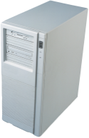


Disintermediation
Production Chain
Manufacturer
E-commerce website
Retailer
Consumer

Slide 15



Airlines and Disintermediation
1960s-1990s
2000-2010
2010-
Airline (American)
Reservation system (Sabre)
Web Sites (Expedia, Orbitz, Travelocity)
Travel agent
Customer

Slide 16


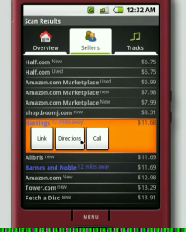
Price Competition
Searches
Google (www.google.com/products)
Bing (Products tab)
Nextag
Barcode scanning, many options
Android
iPhone
Web search
Prices and more
http://scan.jsharkey.org/

Slide 17
MSRP and the U.S. Supreme Court
Manufacturer Suggested Retail Price
For almost 100 years in the U.S., manufacturers could suggest a retail price of a product but antitrust law prevented them from enforcing that price.
In 2007, the U.S. Supreme Court in a 5-4 decision, overturned the law
Leegin Creative Leather Products, Inc. v. PSKS, Inc., dba Kay’s Kloset
http://caselaw.lp.findlaw.com/cgi-bin/getcase.pl?court=US&navby=case&vol=000&invol=06-480
Manufacturers can now stop sales to any retailer who offers discounts on their products.
Reasoning
The basic argument was that local stores provide service and people might use that service for free and go online to find a cheaper price from someone who does not have the costs of a storefront and customer service.
A secondary argument was that it would force retailers to compete across brands instead of within a brand. [But how do you compete if you cannot cut price?]
Alternate opinion: If stores provide a useful service, people would pay for it. The market would determine the value of that service—not an arbitrary value assigned by a manufacturer. And stores could make their own decision to sell products online at a discount. Ultimately, manufacturers who understand economics will reconfigure their prices.

Slide 18
Dynamic Pricing
P
S
Price consumer is willing to pay
Perfect competition price
D
Q
The ultimate goal is to set individual prices for each consumer to capture the maximum price each is willing to pay. As opposed to the perfect competition price, where everyone pays the same price, and some customers gain because they were willing to pay more.

Slide 19
Making Money on the Internet
Sell products
Sell services
To consumers (financial, match making, …)
To businesses (Web services, CRM, …)
Sell advertising
Sell stock—which means convincing investors that you will someday make a profit doing one of the above

Slide 20


Consumer Services: Social Networking
Google Ads
$
Advertiser
Facebook
$
Content
Ad

Slide 21


Distributed Services
Original
document
Company 1
The Internet
Internet Service
e.g., automated document translation
Company 2
Translated
document

Slide 22

E-Commerce Risk Mitigation
It is critical that vendors protect their databases.
Consumer is protected by credit card company.
Encrypt(Database)
Encryption protects transmission of data and verifies identity of vendor.
Vendor
Encrypt(credit card data)
Verify vendor identity.
products or services
Vendor is not protected by credit card and has only weak methods to verify customer identity.
Customer

Slide 23
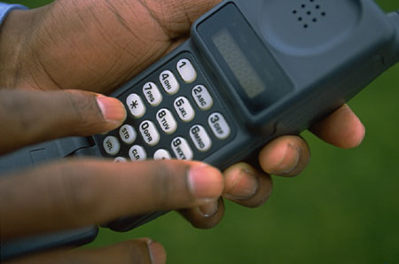
Payment Mechanisms
Credit card drawbacks
High transaction costs.
Not feasible for small payments.
Only some protection for merchants.
Characteristics needed
Low enough costs to support payments less than $1.
Secure transmission.
Authentication mechanism.
Easy translation to traditional money.
Alternatives
Mobile phone bill.
Smart cards.
Digital cash.
Smart Card
5400-1111-0000-
Name

Slide 24

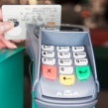



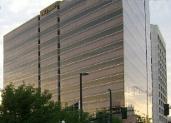
Credit Card Industry
VISA, MasterCard,
AmEx, Discover, JCB, …
Security Database
Card Processor
Authorization data
Payment data
Issuing Bank
Merchant Bank
Customer
Payment data
Merchant
Product/service

Slide 25


Digital Cash
Trusted Party
Service
Conversion to real money
(3) Cash amount is verified and added to vendor account.
Bank
(1) Consumer purchases a cash value.
Vendor
(2) Customer chooses product, sends ID or digital cash number.
PayPal is similar, but takes a more interactive role in every transaction. All item data is sent through PayPal.
Consumer

Slide 26
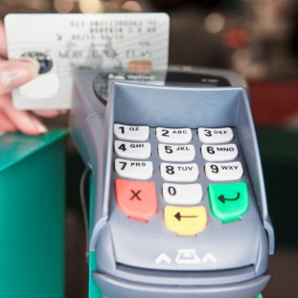
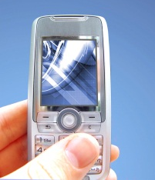
Near Field Communication Payment
Prepaid account
Debit account
Bank
price
Terminal
inches
Identifier + PIN
Message receipt
Customer

Slide 27
Web Advertising Revenue
IAB: http://www.iab.net/resources/ad_revenue.asp
And Google 10-Q statements. Some revenue is not advertising, but…
IAB says top 10 companies generate over 70% of the revenue

Slide 28

Web Advertising Placement
Publisher Website
negotiate sites
negotiate ads
Browse info
page + ad link
DoubleClick/Google
Advertisers
ad
request page
Ad
content
Rotate ads
Track hits
Collect money
Distribute payments
Track customers
User Web browser

Slide 29
Web Advertising: Advertiser Perspective
Want viewers to see the ad.
Want viewers to click through to the main site.
Want to collect contact information from viewers.
Need to match site demographics to target audience.
Monitor response rates.
Cost.

Slide 30
Web Advertising: Publisher Perspective
Income
Cost per thousand viewings ($1 - $50)
Need volume (25,000 or 1,000,000 per month)
Need demographics
Tasks
Ad rotation software
Tracking and monitoring
Ad sales staff
Billing
Third Party: DoubleClick

Slide 31
Google AdWords
Advertisers purchase keywords
When users search for something Google displays ads that match the keyword
If a user clicks on an ad, the advertiser is charged.
Advertiser Complications
Choose keywords that users are likely to enter.
Prices are not fixed—advertisers bid for keywords and the highest bids at any point in time are placed at the top.
Advertisers set daily budgets. When a budget is reached the ads are no longer displayed.
Any Web site owner can join Ad words and place ads on a page. Google pays a portion of the revenue to the owner when an ad is clicked.

Slide 32
Google Keywords
Decisions
Keywords and phrases
Price per click to bid
Daily budget—be careful
Support data from Google
Number of monthly searches by keyword
Estimated average cost per click
Estimated ad position
Check your competition!

Slide 33
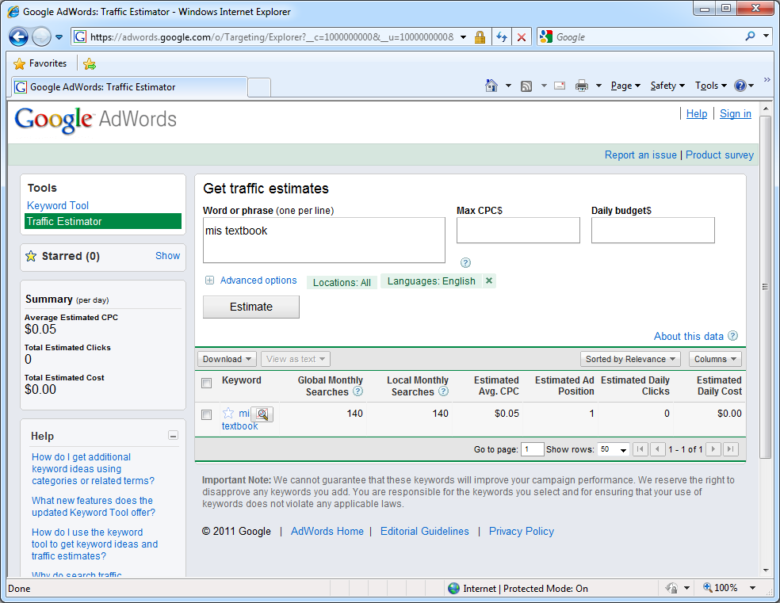
Keyword Selection and Pricing

Slide 34
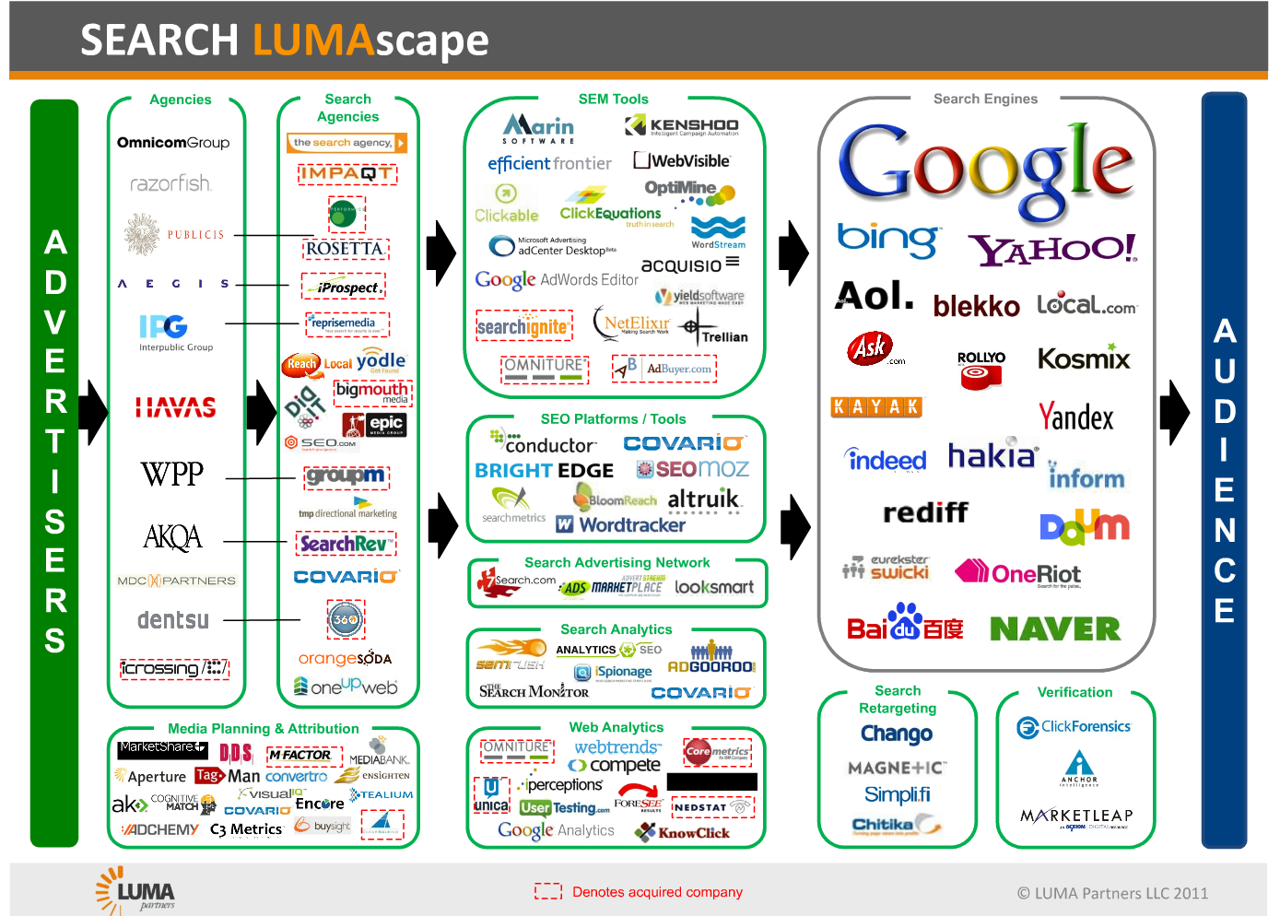
Online Advertising Becomes Complex
http://www.lumapartners.com/resource-center/lumascapes-2/

Slide 35
Privacy
Set your browser to block third-party cookies.
Optionally, use “private” browsing mode, but it might not work with some Web site features.
Watch for newer opt-out tools
More extreme: Edit the hosts file to completely block an ad site:
127.0.0.1 ads.doubleclick.net

Slide 36
Web Hosting Options
Business Situation | Hosting Options
Small business with a few basic items. | Static HTML with a Buy Now button.
Unique items of uncertain value. | eBay auction.
Many items but minimal configuration issues. | Web commerce server hosted by third party.
Many unique items and merchant identity is not critical. | Amazon WebStore.
Unique service. | Custom programming, probably run on a hosted server.
Custom application with tight linkages to in-house applications and databases. | Custom programming running on your own servers. Rare.

Slide 37
Simple Static HTML Web Site
Main Web Page
Categories
…
Category 1
Product photo
… …
Category 2
Product photo
… …
Category 3
Product photo
… …
Product 1
Description
Price
Photo
Product 2
Description
Price
Photo
Product 3
Description
Price
Photo
Product n
Description
Price
Photo

Slide 38
Simple Web Site with Buy Now Button
Merchant Web site
Card Processor Site
Product
Description
Price
Buy Now
Shopping Cart
Item Price
… …
Total
Credit Card Data
Name
Address
Phone
Card Number
Check Out
Submit
Notify merchant
Customer
Notification
(Accept/Reject)
http://www.goemerchant.com/index.htm
http://www.paypal.com
http://checkout.google.com

Slide 39
Web Auctions
Uncertain price
Can set reserve price
Good for unique items
Efficiency depends on
Full information
Adequate number of participants

Slide 40



Amazon WebStore (MarketPlace)
Search
Cameras
Description
Catalog
Database
Price
Vendor Transfer
Description
Price
Scanned image
Contact info
Checkout
Consumer
Product search
Choose vendor
Pay for item
Transaction Processing
Amazon.com handles credit
Sends order info to merchant
Merchant ships item to consumer

Slide 41
Web Commerce Servers
Your Web site
Products
Shopping cart
Sales
Merchants
Customers
Commerce Server Shell
Load database
Images
Descriptions
Prices
Customize site
Database
Web servers
Web/Commerce Hosting Company

Slide 42


Application Service Provider
Business Application
e.g., Accounting
Store data
Analyze data
Facilitate company
interaction
Businesses that lease the use of the application

Slide 43
Web Hosting Options
Business Situation | Hosting Options
Small business with a few basic items. | Static HTML with a Buy Now button.
Unique items of uncertain value. | eBay auction.
Many items but minimal configuration issues. | Web commerce server hosted by third party.
Many unique items and merchant identity is not critical. | Amazon MarketPlace.
Unique service. | Custom programming, probably run on a hosted server.
Custom application with tight linkages to in-house applications and databases. | Custom programming running on your own servers.

Slide 44
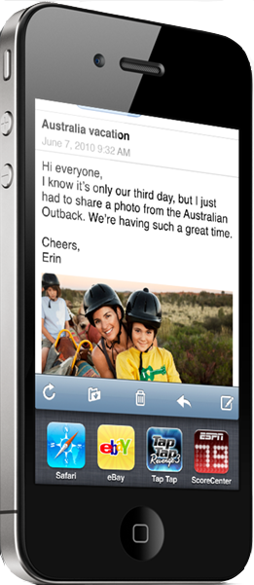
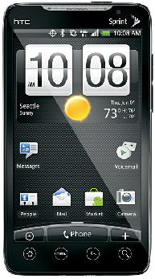
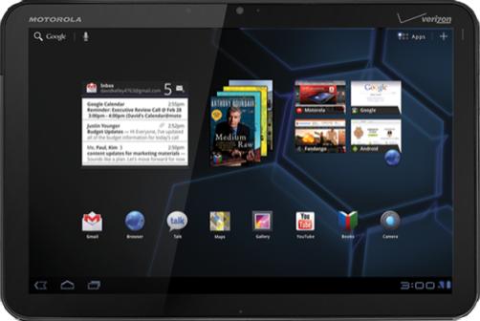
Mobile Commerce
Apple iPhone
Motorola Xoom
HTC Evo
As cell phones and tablet computers converge; people can connect to any business every place they go.

Slide 45
Cloud Computing
Costs
Fixed monthly
Cost per processing
Data storage
Data transfer in and out
Database/software
Examples
Amazon: Elastic Cloud (EC2), Simple Storage Service (S3), Database
Microsoft: Azure and SQL Azure
Rackspace
Equinix

Slide 46
Technology Toolbox: Paying for Transactions
Payment Method | Fixed Cost | Fixed Fee | Discount Fee | Fraud/Insurance
Cash | Low except for security | $0.00 | $0.00 | Physical security
Check-physical | $20/month | $0.25 | 1.7% | Included
Check-electronic | $20/month | $0.25 | 2.5% | Included
Credit Card-physical | $10/month Minimum $25 | $0.25-$0.50 | 1.6% | Covered: 0.08% fraud average
Credit Card-electronic | $30-$50/month Minimum $25 | $0.25-$0.50 | 2.6%-4% | Not covered: 0.25% fraud average
Debit Card | Setup/key pads | $0.35-$0.55 | 0% - 2% | None
PayPal | None | $0.30 | 2.2% - 2.9% | Covered for physical shipments

Slide 47
Quick Quiz: Paying for Transactions
1. Why have consumers rejected most electronic payment mechanisms?
2. What additional fees are charged for international transactions?
3. What happens if a customer refutes a charge?

Slide 48
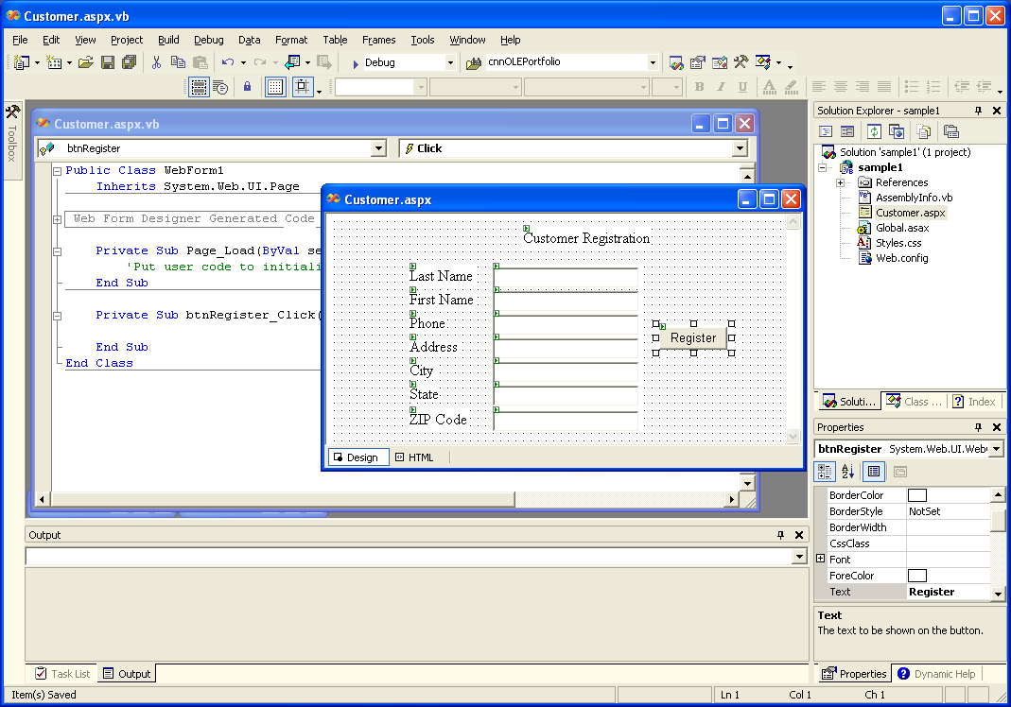
Technology Toolbox: Choosing Web Server Technologies
Main Platforms:
Java: J2EE
IBM Websphere
Oracle
PHP/PERL/PYTHON
Microsoft .NET

Slide 49
Quick Quiz: Web Server Technologies
1. Why would programmers become so attached to one system?
2. What are the advantages of choosing the most popular server technology?
3. What are the dominant costs of creating a website?

Slide 50
Cases: Retail Sales

